Slide 1




My Algebra Interactive Notebook
$$3ab$$
$$2x+3y$$
$$\frac{5xy}{6}$$
Name :
Class :
Term 2 Semester 1
$$y=2x+1$$

Slide 2
Contents
Glossary
Page
Date
Description
2
3

Slide 3
Tasks
24
7
30
Essential Question
Questions
Notes
Summary
4
7

Slide 4
24
7
30
Date
Writing Algebraic Expressions
EQ – How can I use symbols to simplify problems with unknown values?
7

Slide 5
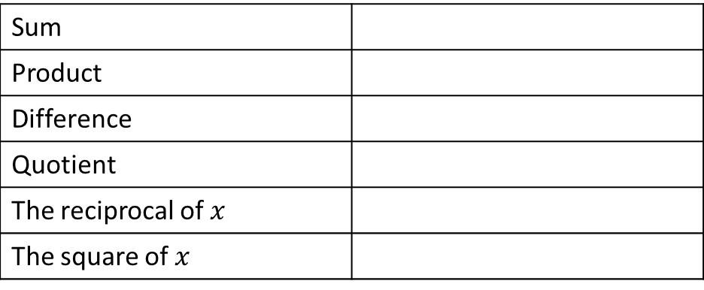
24
7
30
Date
Writing Algebraic Expressions
EQ – How can I use symbols to simplify problems with unknown values?
Sum
Product
Difference
Quotient
The reciprocal of $x$
The square of $x$
7

Slide 6
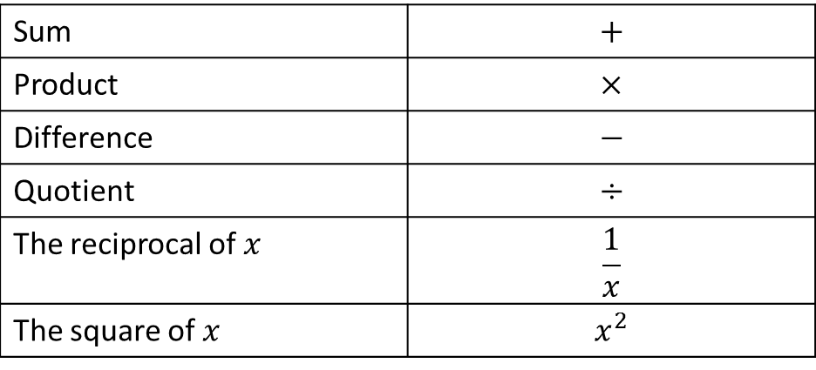
24
7
30
Date
Writing Algebraic Expressions
EQ – How can I use symbols to simplify problems with unknown values?
Sum | $$+$$
Product | $$×$$
Difference | $$−$$
Quotient | $$÷$$
The reciprocal of $x$ | $$\frac{1}{x}$$
The square of $x$ | $$x^{2}$$
7

Slide 7
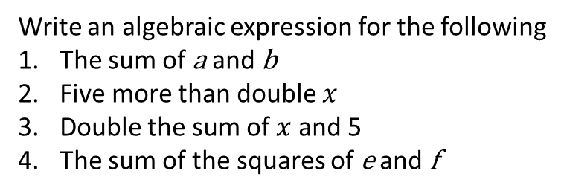
24
7
30
Date
Writing Algebraic Expressions
EQ – How can I use symbols to simplify problems with unknown values?
Sum | $$+$$
Product | $$×$$
Difference | $$−$$
Quotient | $$÷$$
The reciprocal of $x$ | $$\frac{1}{x}$$
The square of $x$ | $$x^{2}$$
Write an algebraic expression for the following
The sum of a and b
Five more than double $x$
Double the sum of $x$ and 5
The sum of the squares of e and f
7

Slide 8
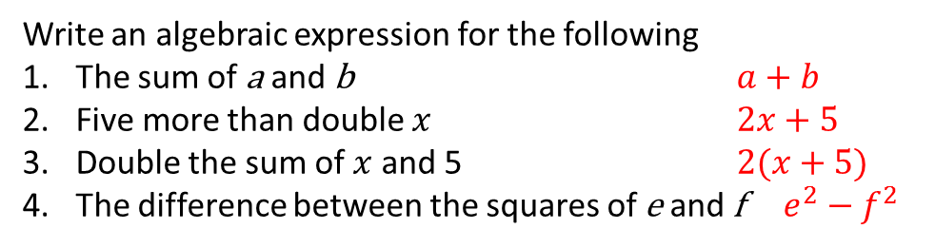
24
7
30
Date
Writing Algebraic Expressions
EQ – How can I use symbols to simplify problems with unknown values?
Sum | $$+$$
Product | $$×$$
Difference | $$−$$
Quotient | $$÷$$
The reciprocal of $x$ | $$\frac{1}{x}$$
The square of $x$ | $$x^{2}$$
Write an algebraic expression for the following
The sum of a and b $a+b$
Five more than double $x$ $2x+5$
Double the sum of $x$ and 5 $2(x+5)$
The difference between the squares of e and f $e^{2}−f^{2}$
7

Slide 9
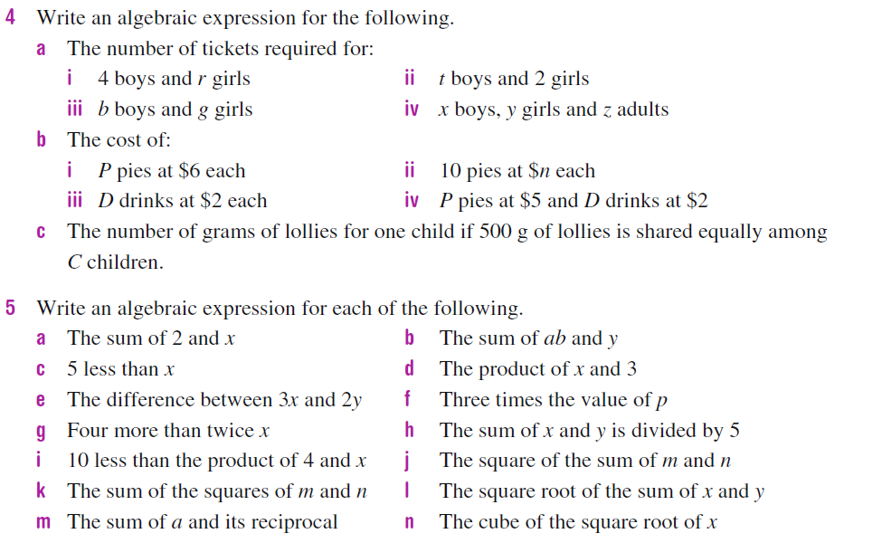
Task

Slide 10
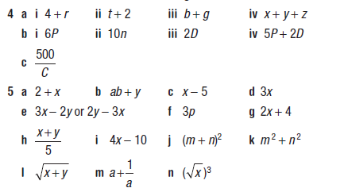
Answers

Slide 11
Fill in the questions

Slide 12
Notes Review
24, 7 ,30
Date
Title
Essential question
Notes complete
Notes complete with colour and diagrams
Questions completed
Contents page filed in
Formula page filled in

Slide 13
Homework
Review your notes and write a summary answering the essential question.

